Slide 1

Notes:
Mike will welcome everyone and remind them to put their name and organization in the chat box.

Slide 2
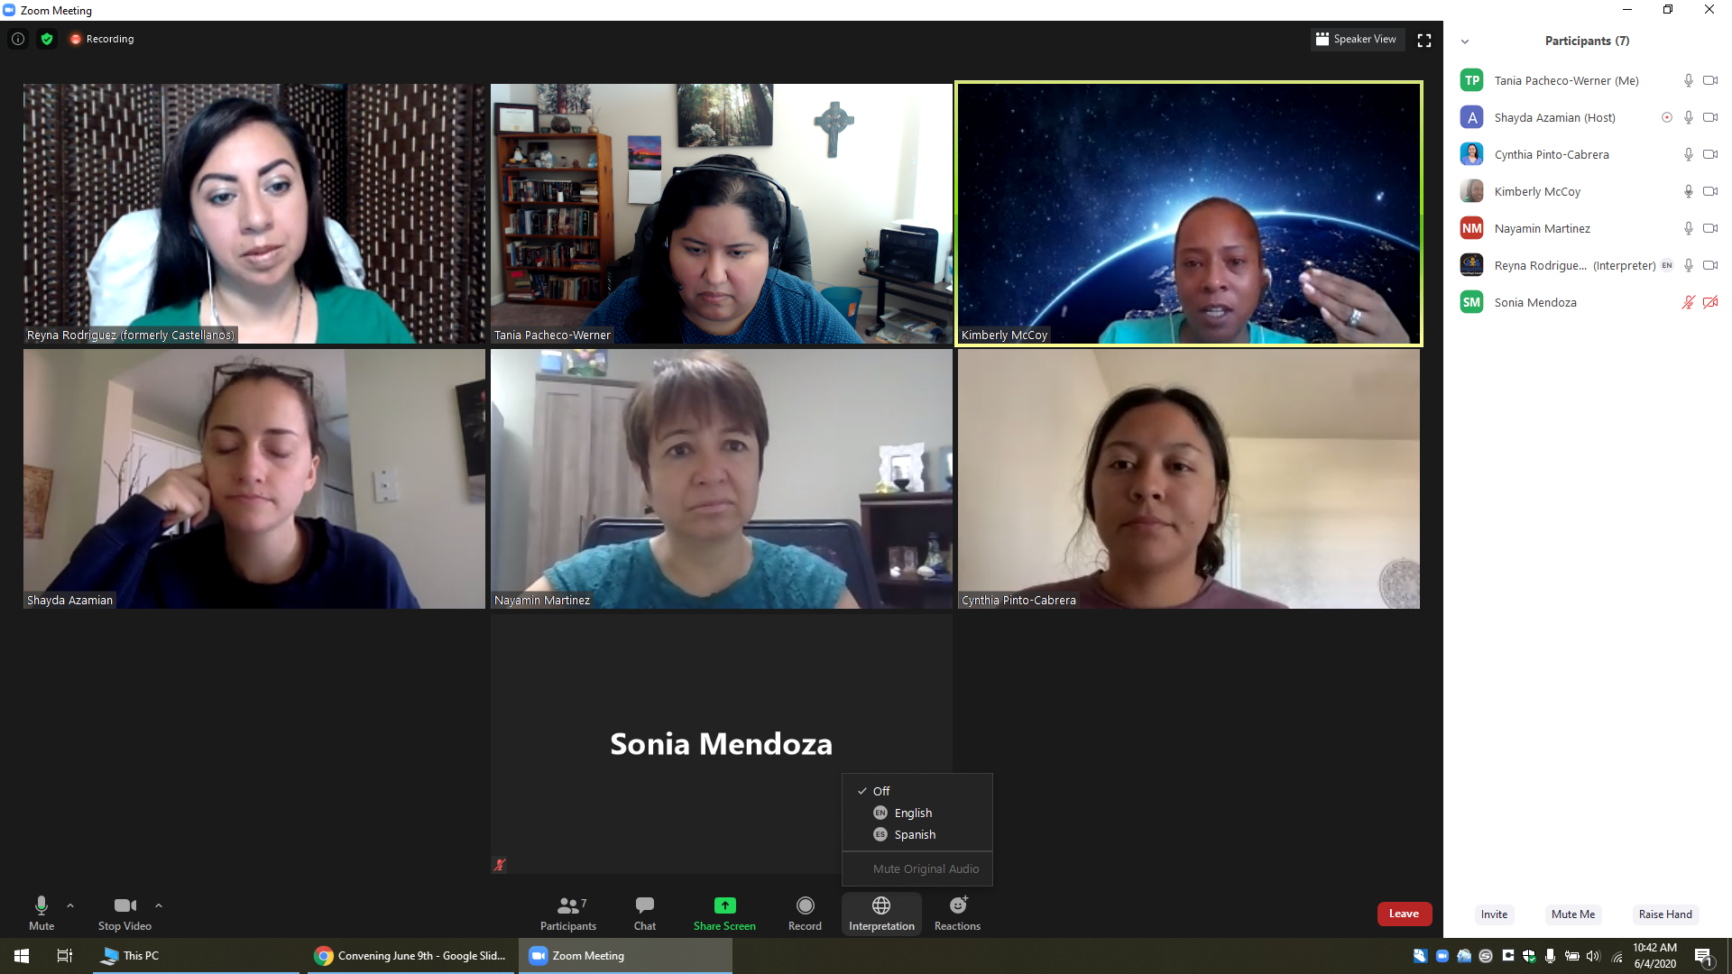
Welcome, Instructions for Zoom
Bienvenidos, Instrucciones para Zoom
Select the World Icon, Then Pick Your Prefered Language
Selecciona el Icono de Mundo, Elije Tu Idioma Preferido
The meeting will have simultaneous interpreting, so you are welcome to comment in your native language.
La junta será interpretada simultáneamente, así que le invitamos a que haga comentarios en su lenguaje nativo.
Tech support:
Para Apoyo Técnico:
Notes:
Nayamin

Slide 3
AGENDA
Vision and Mission Voting Results
Group Norms
Meet the Presenters
Introduce Problems to Policies
Examples
Resident Engagement
Extended Learning and Next Steps
Community Resources
Notes:
Mike 2 min

Slide 4
Let’s look at our results of our vision and mission statements…
t
Notes:
Wendy will share the results for the top vision and mission statement.
3 minutes

Slide 5
Let’s review our norms...
1. Be open to new ideas
2. Listen to each speaker
3. Make equal time for all to share
4. In person meeting: Please keep your phone on silent, and if you
need to answer the phone, please excuse yourself from the room.
5. During a virtual meeting we encourage you to have the camera on
to be fully engaged, keep your audio on mute
6. Treat others the way you would like to be treated
7. Use the hand icon if you have a question or comment, or put it in
the chat.
Notes:
Wendy 2 min

Slide 6

OUTCOME FOR THIS TRAINING training
Today we will learn how to flex our power to identify a problem and move toward a policy change.
Notes:
Mike 2 min

Slide 7
Vocabulary
System- a set of things working together as parts of an interconnecting network
Policy- a course or principle of action adopted or proposed by a government,
party, business or individual.
Values- one’s judgement of what is important in life
Notes:
Wendy reviews vocabulary 3 min

Slide 8
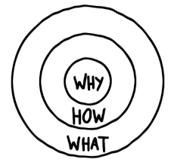
Why, How, What?
“Why” will always drive this work with the vision in mind created with our values.
“How” will include our mission statement and goals to achieve in this process.
“What” is the product we will create in the end together.
These are the Big Ideas!
Notes:
Mike explains the Golden Circle 5 min

Slide 9


Slide 10

Notes:
2 min

Slide 11

Notes:
2 min

Slide 12


Slide 13


Slide 14
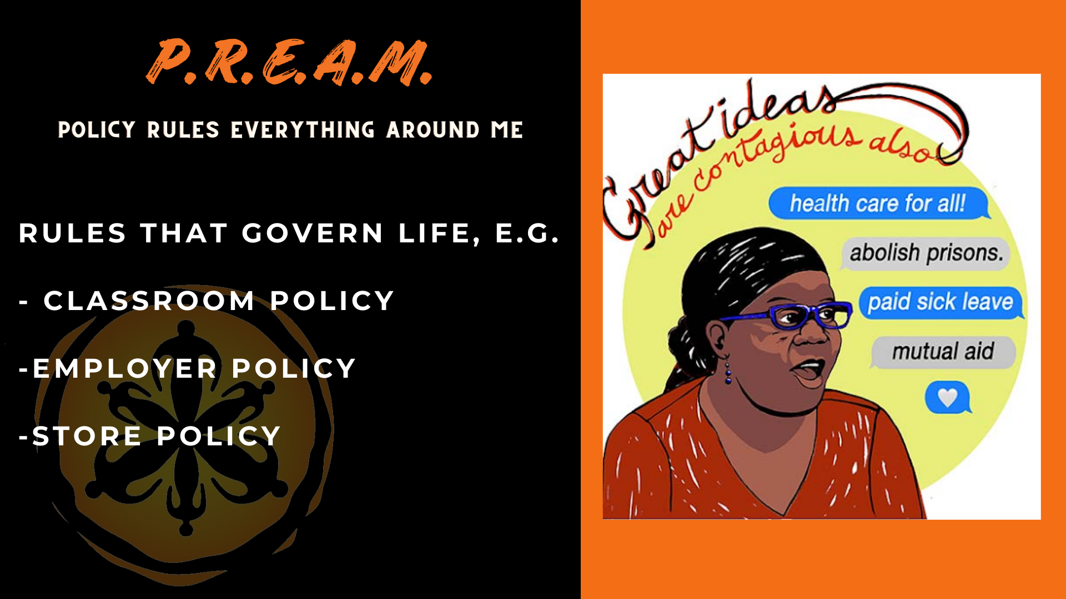

Slide 15
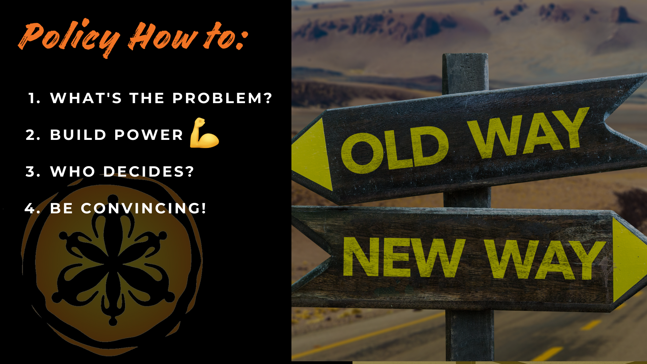

Slide 16


Slide 17
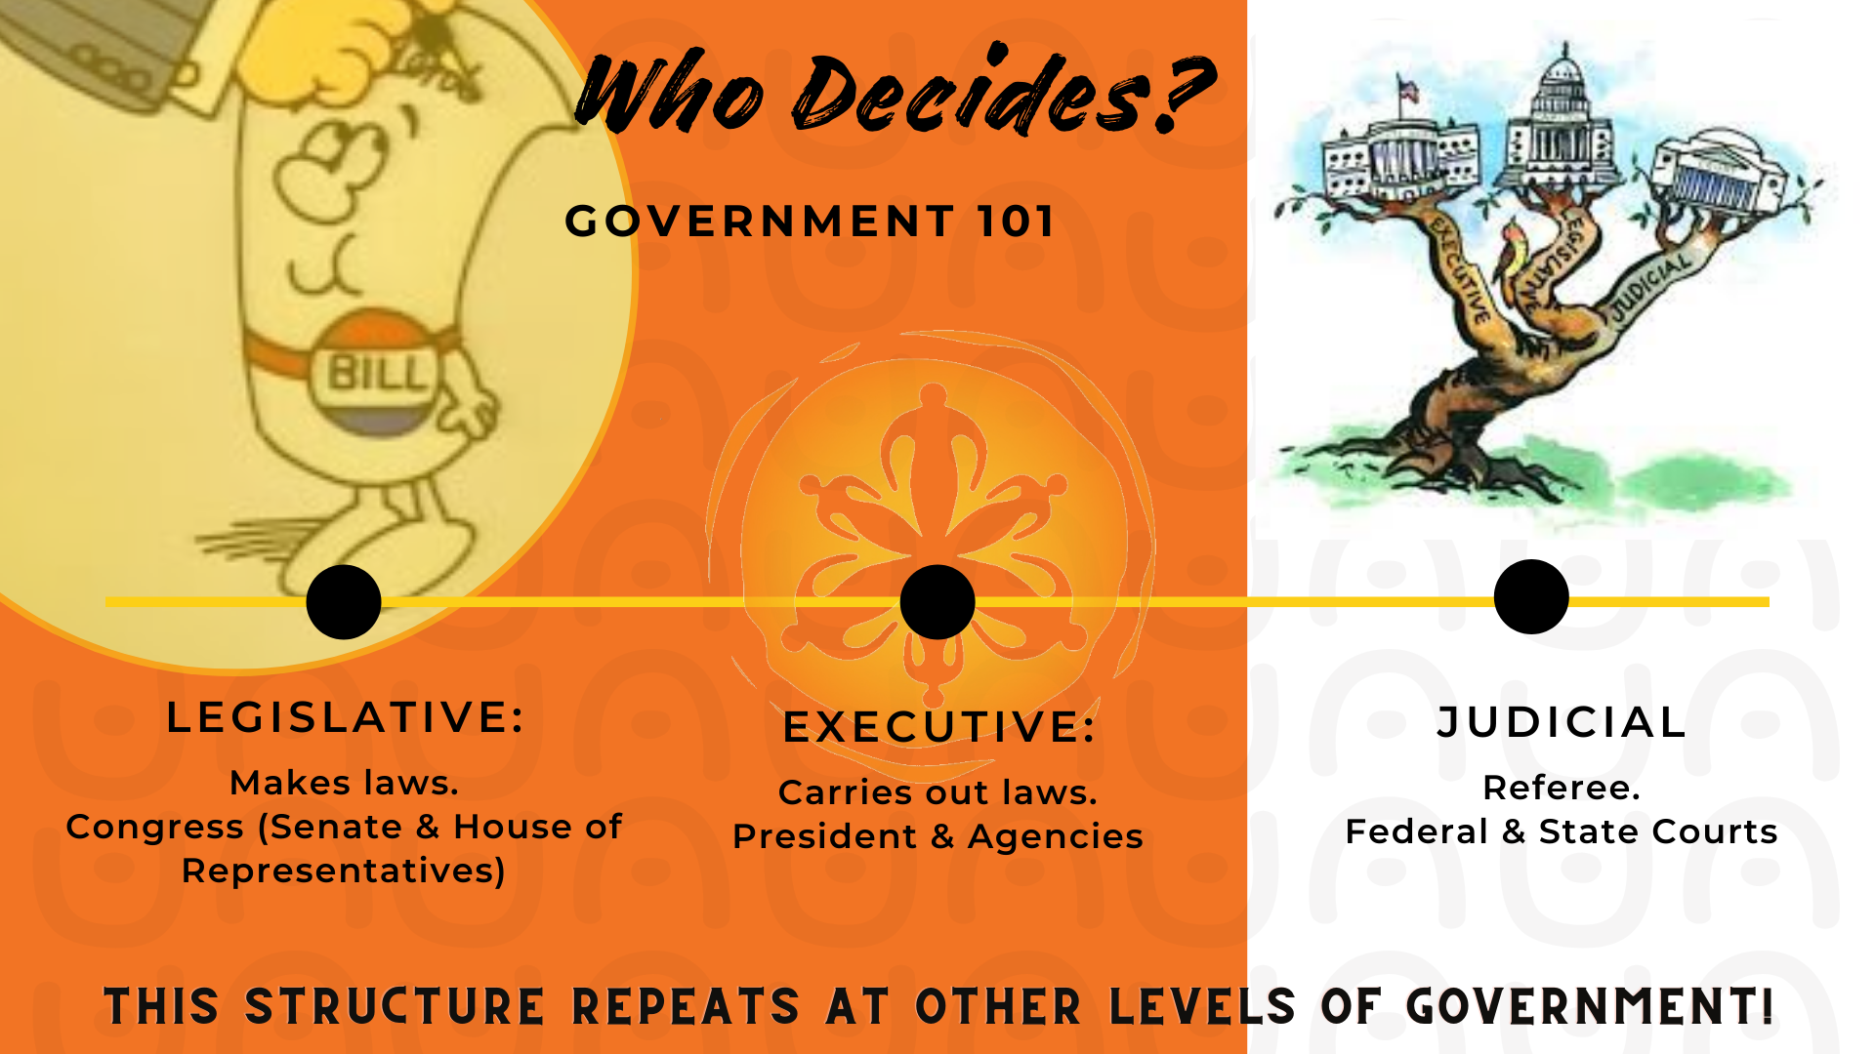

Slide 18


Slide 19


Slide 20
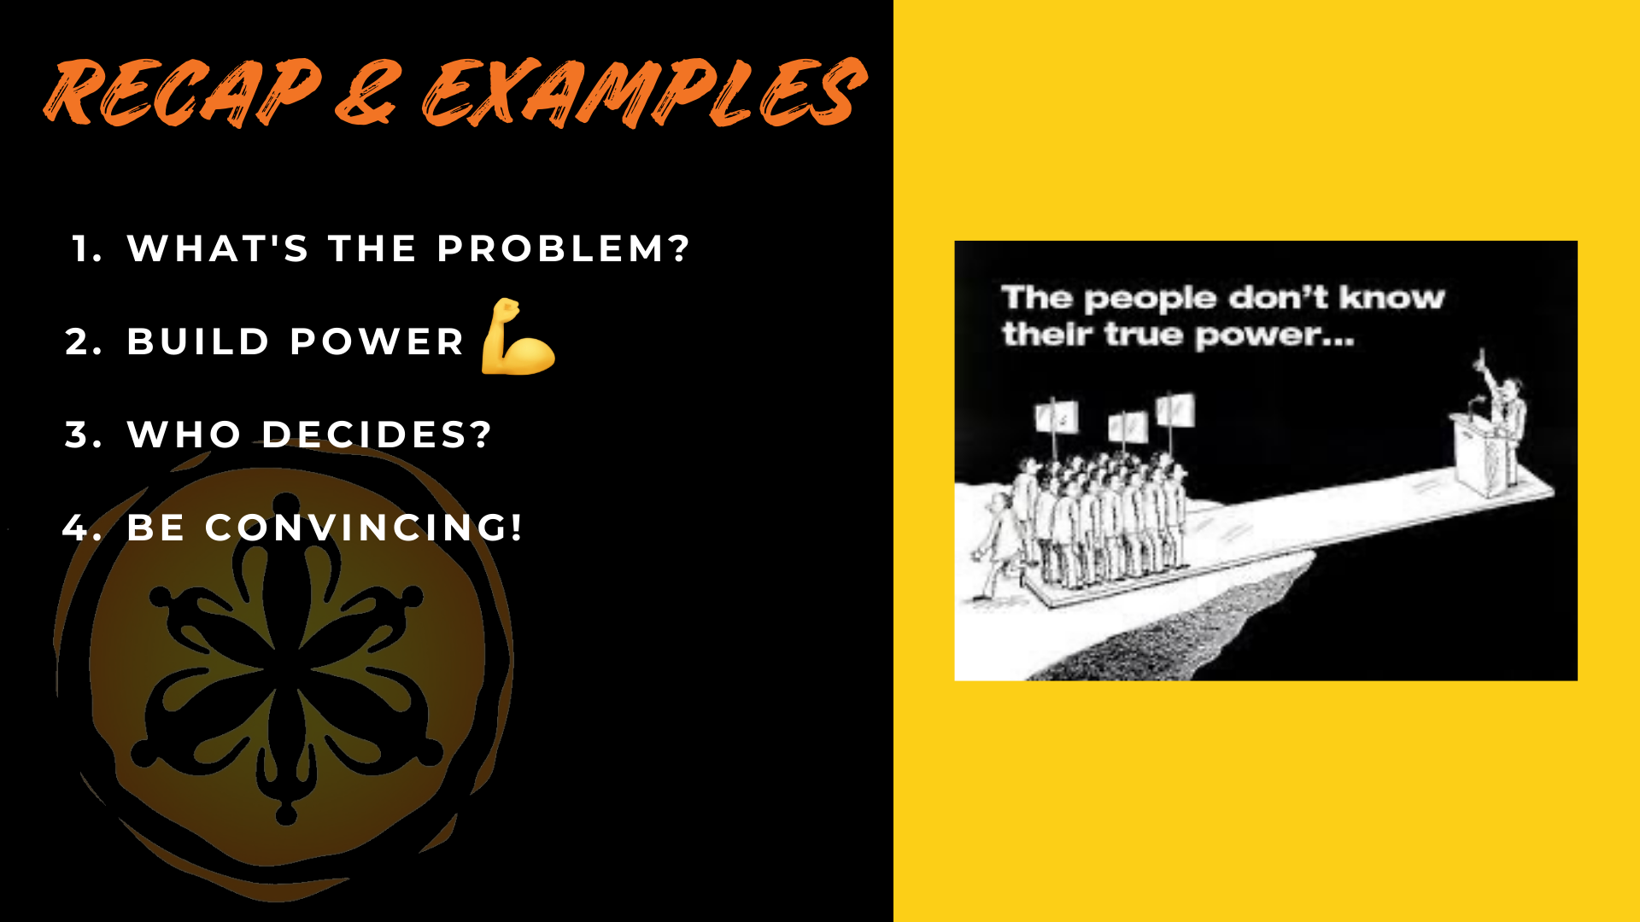

Slide 21
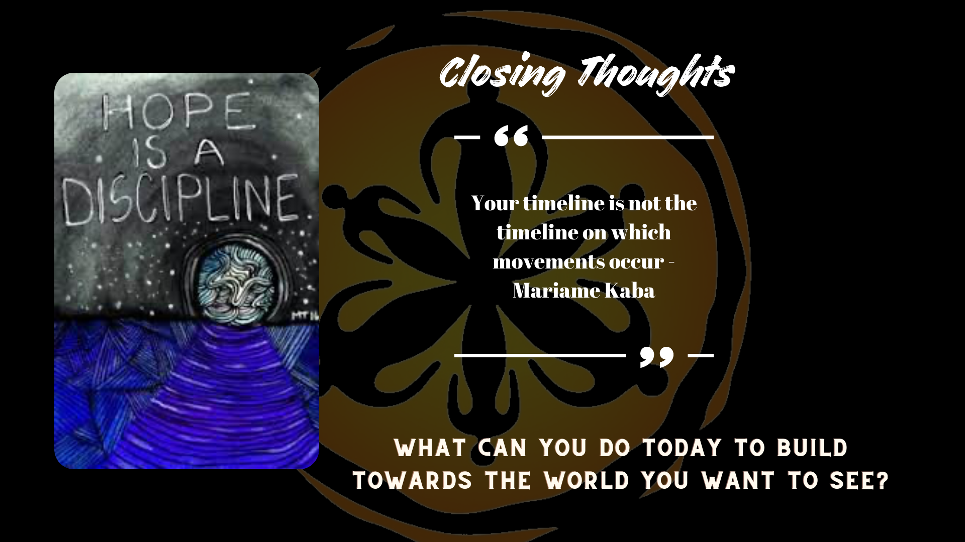

Slide 22


Slide 23
Next Training:
REAP Training #5
Forming a Policy Agenda
Tuesday, November 30th from 5:30-7pm
Or
Saturday, December 4th from 10-11:30am
Notes:
Mike

